Slide 1

OBJECT DETECTION AND CLASSIFICATION USING FASTER RCNN,FAST RCNN
Team members:
AP21110010915
AP21110010931
AP21110010948
AP21110010962
AP21110010970

Slide 2

CONTENTS:
1.Introduction
2.Methodology
3.Results
4.Conclusion
5.Future Work
6.Referencces
AP21110010915

Slide 3

INTRODUCTION:
Object detection in computer vision has become a cornerstone for various real-world applications, ranging from autonomous driving to security systems and image analysis. Deep learning, particularly convolutional neural networks (CNNs), has revolutionized the accuracy and performance of object detection by effectively extracting features from labeled images. The region-based CNN (R-CNN) family stands out as a pivotal model for object identification, incorporating object categorization and region proposal stages. Notable advancements such as Fast R-CNN, Faster R-CNN, and Mask R-CNN have further streamlined processes, enhancing both speed and accuracy. The Single Shot Multibox Detector (SSD) offers another intriguing approach by integrating object classification and region proposal within a single network, eliminating the need for separate proposal creation and significantly reducing inference times. Training on widely used datasets like COCO and Pascal VOC has empowered these models to develop robust object detection and classification skills.
AP21110010915

Slide 4

It's essential to clarify the distinction between terms such as "object recognition" and "object detection" in the realm of computer vision. Object recognition involves making assumptions about the class or kind of an object depicted in an image, providing a class label as output. On the other hand, object detection goes beyond, locating objects in an image, drawing bounding boxes around them, and identifying their classes. Object localization, which entails drawing bounding boxes around individual items, and object classification, classifying the entire image, are combined in object detection. Region-based convolutional neural networks, exemplified by Faster R-CNN, have played a crucial role in addressing both object localization and recognition challenges. Faster R-CNN's two-stage methodology, involving region proposal and subsequent object categorization and refinement, strikes a balance between accuracy and speed, making it a pivotal tool in advancing fields such as autonomous driving, surveillance, and visual comprehension through precise object recognition.
AP21110010915

Slide 5

ABSTRACT:
In order to identify, classify, and localize objects in pictures as a unique solution to Computer Vision Real World Domain specific challenges, the generalized object detection framework Faster R-CNN is based on a CNN. Unlike previous object identification algorithms that perceive it as a classification problem, it views object identification as a single regression problem. Due to its efficiency in simultaneously detecting, classifying, and localizing many items from various classes, this complex object detection method has gained popularity. The goal of this project is to build a dataset with various picture formats to implement Faster R-CNN for object detection, classification, and localization. The chosen approach would include detecting, classifying, and localizing persons and objects on the road using a pretrained CNN. This has the potential to be used in active safety systems for driverless cars as well. Additionally, it can be implemented differently to assist with data collection and categorization.
Keywords: - R-CNN, OBJECT DETECTION AND RECOGNITION
AP21110010931

Slide 6
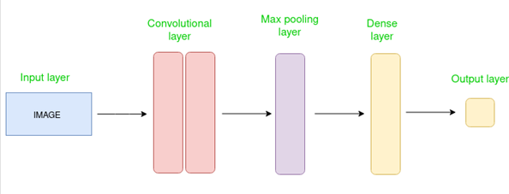
METHODOLOGY:
1.CNN
2.FASTER R-CNN
3.FAST RCNN
AP21110010931

Slide 7
CNN:
CNN: Convolutional neural networks are DL algorithms that are capable of feature detection on images that are given as input.CNNs can assign weights to different process characteristics. Contrary to manual instruction required for fundamental algorithms, CNNs are capable of learning filters and features on their own. As a result, less preprocessing is required.
Convolutional layers, pooling layers, and fully linked layers are all crucial parts of the ConvNet's basic design, which is shown in FigureCNNs are essentially neural networks, the organisation of the neurons in the brain's visual cortex affects how information is sequenced
AP21110010931

Slide 8
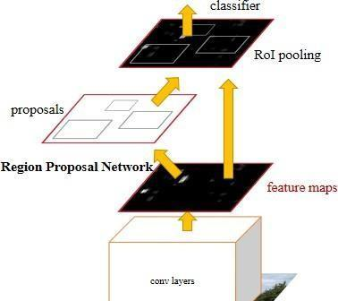
FASTER R.CNN:
Faster R-CNN represents a significant enhancement over its predecessor, Fast R-CNN, by introducing a Region Proposal Network (RPN) for generating Regions of Interest (ROIs). This sophisticated approach leverages feature maps as input, resulting in a comprehensive assessment of objectness through the computation of abasement scores. The process begins with the input image being fed into Faster R-CNN, which utilizes it to construct a feature map for the entire image. The RPN is then applied to these feature maps, producing both objectness scores and object recommendations. The RPN employs sliding windows over these maps and creates anchor boxes of different sizes, each serving two purposes: assessing the probability of the anchor containing objects and refining the anchor through a bounding box regressor.
AP21110010948

Slide 9

In essence, Faster R-CNN operates as a two-stage object identification model within the realm of deep learning. It initiates by identifying Regions of Interest (ROIs) within an image, followed by the application of a Convolutional Neural Network (CNN) to process these ROIs. The subsequent steps involve utilizing a Support Vector Machine (SVM) to further analyze the generated feature maps for object categorization. Additionally, regression techniques are employed to establish the relationship between anticipated bounding boxes and ground truth bounding boxes. This overarching architecture encapsulates the holistic approach of Faster R-CNN, making it a pivotal model in the domain of object detection.
AP21110010948

Slide 10
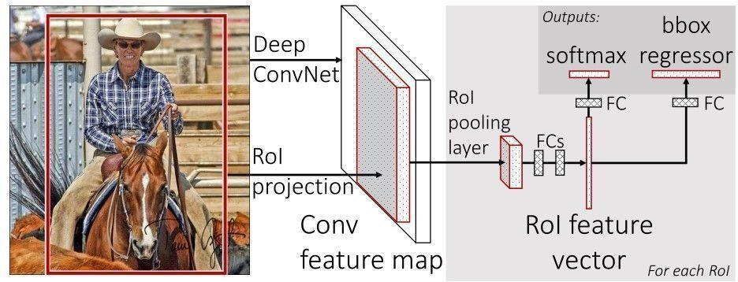
FAST R-CNN:
Fast R-CNN, an advanced model for object detection, builds upon the R-CNN strategy to achieve notable improvements in both accuracy and speed. Addressing the limitations of R-CNN, such as slow training and inference times, Fast R-CNN introduces key architectural changes and a refined training procedure. The crucial components of Fast R-CNN include a streamlined region proposal process, a convolutional neural network (CNN) backbone, RoI pooling for feature extraction, fully connected layers for classification and regression, a multi-task loss function, and a two-stage training approach involving pre-training and fine-tuning.
The Fast R-CNN algorithm operates through a systematic process: starting with an input image, the CNN backbone processes the image hierarchically, generating feature maps. Subsequently, a region proposal network (RPN) creates probable object regions based on these features, predicting the likelihood of each region containing an object. RoI pooling is then employed for each proposed region to ensure efficient and uniform feature extraction from the CNN backbone, irrespective of region size. Fully connected layers handle object classification and bounding box regression, with a multi-task loss function combining classification and regression losses.
AP21110010948

Slide 11

Fast R-CNN's training occurs in two stages, utilizing a large dataset for pre-training the CNN backbone on general characteristics and fine-tuning the RPN and fully connected layers on the target dataset through backpropagation. During inference, the full input image passes through the CNN backbone, generating region proposals via the RPN, extracting features through RoI pooling, and utilizing fully connected layers for final predictions. Non-maximum suppression (NMS) is applied to remove overlapping and redundant detections, yielding a precise collection of identified objects, along with corresponding class labels and bounding box coordinates.
The incorporation of RoI pooling in Fast R-CNN significantly enhances the original R-CNN method by enabling more efficient and accurate feature extraction from region proposals. This improvement, coupled with the elimination of costly per-region computations, accelerates both training and inference. The joint training of classification and bounding box regression tasks further enhances localization accuracy, making Fast R-CNN a pivotal advancement in object detection.
AP21110010962

Slide 12
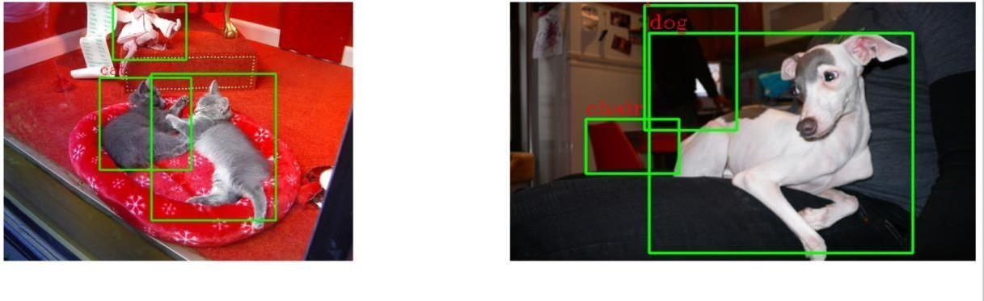
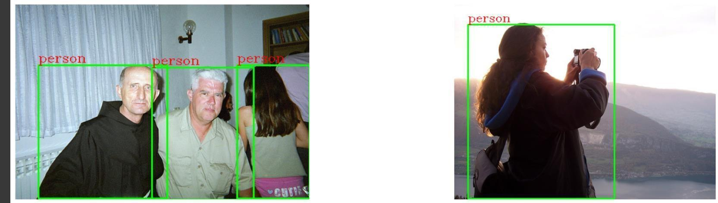
RESULTS:
In this project, we have implemented FASTER RCNN, and FAST RCNN algorithms, and to train these algorithms, we have the PASCAL VOC2012 dataset. We have done this algorithm using jupyter notebook, and below are the results.
AP21110010962

Slide 13
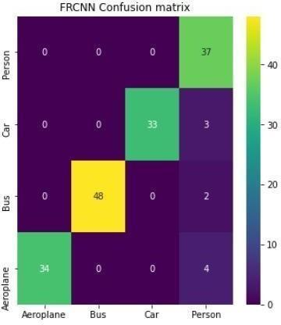
FASTER R-CNN DETECTION OUTPUTS:
Using the previously described FRCNN, we were able to achieve a high accuracy of 95% in the evaluation. Several metrics, such as accuracy, precision, recall, and F-score, were used to assess the performance. The confusion matrix graph's x-axis displays the expected labels, and the y-axis displays the actual labels. The diagonal boxes in different colors display the accurate forecast counts, while the blue boxes represent the few incorrect guesses. In the ROC graph, the True Positive Rate is displayed by the y-axis, and the Positive Rate is displayed by the y-axis.
AP21110010962

Slide 14

ACCURACY AND PRECISION:
Using the previously described FRCNN, we were able to achieve a high accuracy of 95% in the evaluation
AP21110010970

Slide 15
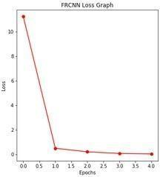
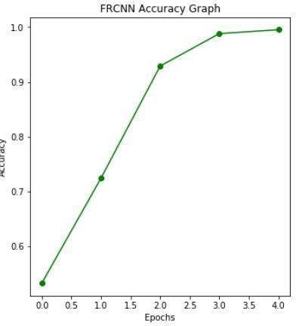
FRCNN ACCURACY GRAPH: ACCURACY AND lOSS
The training accuracy and loss of the FRCNN model are shown in the graphs above. The y-axis displays the appropriate accuracy and loss values, while the x-axis displays the number of training epochs. The graph clearly shows that as the number of epochs rises, the model's accuracy rises and the loss falls.
AP21110010970

Slide 16

CONCLUSION:
In conclusion, object detection, which includes locating and recognizing items inside digital photos or videos, is a critical computer vision problem.
Faster R-CNN, on the other hand, employs a two-stage methodology to get more accuracy. It initially creates a number of area ideas, which are then categorized and improved using a different region classification network. Although it can be computationally more expensive, this technique often performs better in situations where exact object localization is important.
Faster R-CNN has been a significant contributor to object identification, finding widespread application in various fields. Its strengths lie in object tracking, aerial picture analysis, and medical imaging, owing to its enhanced accuracy. Unlike YOLO, which excels in real-time applications, Faster R-CNN's impact is more pronounced in scenarios where precision is paramount.
Anticipated advancements in Faster R-CNN and related methodologies are likely to center on refining occlusion handling, bolstering adaptability across diverse scenarios, and leveraging contextual cues. These developments aim to further enhance its capabilities in perceiving complex environments. Ultimately, these strides will aid in augmenting how robots interpret and engage with the visual world.
AP21110010970

Slide 17

FUTURE WORKS:
The goal of future work on object detection utilising YOLO models and Faster R-CNN is to solve current constraints and investigate new directions to further improve performance
AP21110010970

Slide 18
REFERENCES:
R-CNN: Girshick, R., et al. (2014). Rich feature hierarchies for accurate object detection and semantic segmentation. In Proceedings of the IEEE Conference on Computer Vision and Pattern Recognition (CVPR).
Fast R-CNN: Girshick, R. (2015). Fast R-CNN. In Proceedings of the IEEE International Conference on Computer Vision (ICCV).
Faster R-CNN: Ren, S., et al. (2015). Faster R-CNN: Towards real-time object detection with region proposal networks. In Advances in Neural Information Processing Systems (NeurIPS).
Girshick, R.; Donahue, J.; Darrelland, T.; Malik, J. Rich feature hierarchies for object detection and semantic segmentation. In Proceedings of the IEEE Conference on Computer Vision and Pattern Recognition, Columbus, OH, USA, 24–27 June 2014. [Google Scholar]
] S. Ren, K. He, R. Girshick, X. Zhang, and J. Sun. Object detection networks on convolutional feature maps. arXiv:1504.06066, 2015.
M. D. Zeiler and R. Fergus. Visualizing and understanding convolutional neural networks. In ECCV,2014
K. Chatfield, K. Simonyan, A. Vedaldi, and A. Zisserman. Return of the devil in the details: Delving deep into convolutional nets. In BMVC, 2014.
D. Erhan, C. Szegedy, A. Toshev, and D. Anguelov. Scalable object detection using deep neural networks. In CVPR, 2014.
T. Lin, M. Maire, S. Belongie, L. Bourdev, R. Girshick,J. Hays, P. Perona, D. Ramanan, P. Dollar, and C. L. Zit- nick. Microsoft COCO: common objects in context. arXive-prints, arXiv:1405.0312 [cs.CV], 2014.
Ren, S.; He, K.; Girshick, R.; Sun, J. Faster r-cnn: Towards real-time object detection with region proposal networks. arXiv 2015, arXiv:1506.01497.
Cai, Z.; Vasconcelos, N. Cascade R-CNN: High quality object detection and instance segmentation. IEEE Trans. Pattern Anal. Mach. Intell. 2019, 43, 1483– 1498.
Pinle, Q.; Chuanpeng, L.; Jun, C.; Chai, R. Research on improved algorithm of object detection based on feature pyramid. Multimed. Tools Appl. 2019

Slide 19


